Slide 2
Class 10
Query Compilation

Slide 3
Turn video on, open chat,
greet your colleagues in the chat!
Warmup discussion:
What are some types of disaggregation in your daily life?
When is it sensible to disaggregate vs consolidate?

Slide 4

Logistics
Thanks for the bug reports!
Vote: Share and review paper drafts (due 10-22)?

Slide 5
DB seminar talks
9/29 Julia Stoyanovich (NYU)
Responsible Data Management
10/13 Wolfgang Gatterbauer (Northeastern)
QueryVis
10/20 Kostas Karanasos (Microsoft Gray Labs)
Lab overview + In-db ML inference
10/27 Vasiliki Kalavri (Boston U)
Streaming Research
11/10 Aaron Elmore (UChicago)
CrocodileDB
Zoom link in slack

Slide 6
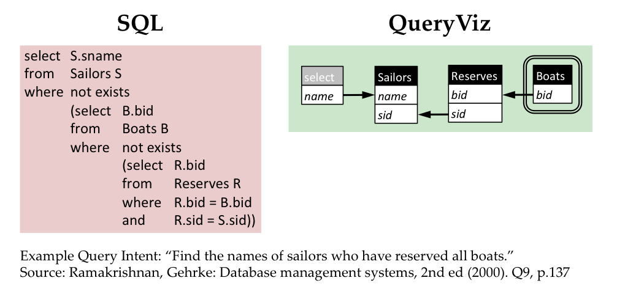
Queryvis.com

Slide 7
Breakout Qs
Choose a notetaker that as not been a notetaker in the past

Slide 8
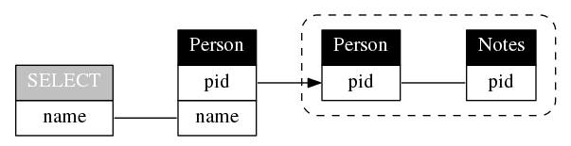
Breakout Qs
Choose a notetaker that as not been a notetaker in the past
SELECT name
FROM Person P
WHERE P.pid NOT IN (
SELECT P2.pid
FROM Person P2, Notes N
WHERE P2.pid = N.pid
)

Slide 9
Breakout Qs.
G1: Compare Hyper’s compilation vs MonetDB’s vectorization or Volcano. In what specific cases is one better and why?
G2: What logic makes sense to keep in C++ as opposed to LLVM? List some examples and why.
G3: How is query compilation tricky from a software engineering perspective? What could be done to improve this aspect?
Each group assigns notetaker to report back (1m)

Slide 10

Support your colleagues
for speaking up
A quick thanks or follow up
is great
https://en.wikipedia.org/wiki/Thumb_signal

Slide 11
Breakout Qs.
G1: Compare Hyper’s compilation vs MonetDB’s vectorization or Volcano. In what specific cases is one better and why?
G2: What logic makes sense to keep in C++ as opposed to LLVM? List some examples and why.
G3: How is query compilation tricky from a software engineering perspective? What could be done to improve this aspect?
Each group assigns notetaker to report back (1m)

Slide 12
Class 9
Cloud DBs

Slide 13

Turn video on, open chat, then click
Warmup discussion:
You’ve read industry and academic papers.
What do you feel are the strengths and weaknesses?

Slide 14
Logistics
A3 released
A5 is extra credit (optional)
Proposal comments sent via slack
Keeping existing lecture sequencing
was partly to time with Prof Vasiliki’s talk

Slide 15
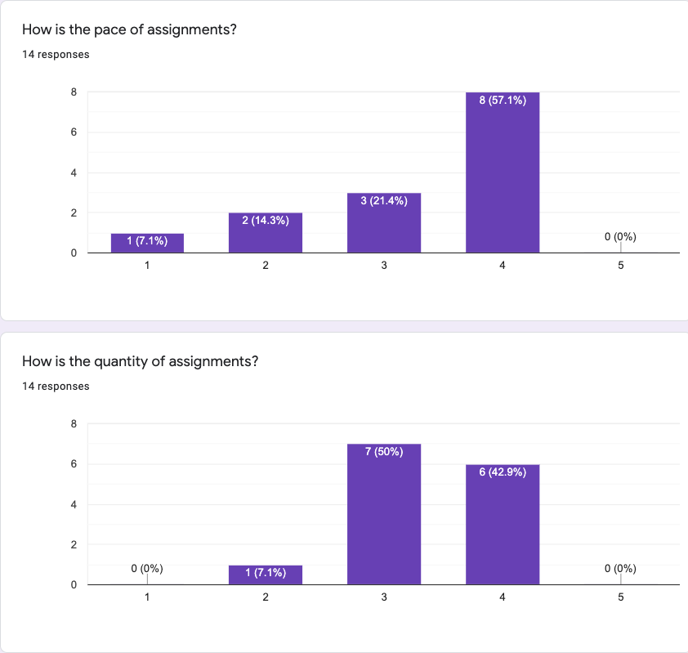
Comments
Almost Unrelenting
Go over assignment & concepts in class (x2)
More tests (x4)
Note: 5 late days

Slide 16
Breakout Qs.
G1: What are the similarities between Dremel/Snowflake and Gamma? What are the differences?
G2: Does in-situ processing really mean? For instance, does data not need to be loaded? What are its strengths and drawbacks?
G3: Speculate about future iterations software or hardware “disaggregation. How might it affect DBMS design?
Each group assigns notetaker to report back (1m)

Slide 17
Class 8
Column Stores

Slide 18
Turn video on, open chat, then click
Warmup discussion:
Which restaurant do you want to go most
when dine-in is safe again?

Slide 19
Logistics
Proposal due today 11:59PM EST
A2 due 10/4 11:59PM EST
A5 is now optional
Questions
Extend A3 and A4 by 1 week?
Swap Compilation/Udf topics with large scale dataflow?

Slide 20
Breakout Qs.
G1: What makes this paper well-written? Identify specific examples from the reading.
G2: Still assuming a ”big reads” workload, how would col-stores adapt to data distribution changes?
G3: Compare and contrast the in-memory vs on-disk “stores” in c-store to the design in a class RDBMS
Each group assigns notetaker to report back (1m)

Slide 21
Class 7
Query Optimizer

Slide 22
Turn video on, open chat
Warmup discussion:
Is a hot dog a sandwich?
3. Click when done

Slide 23
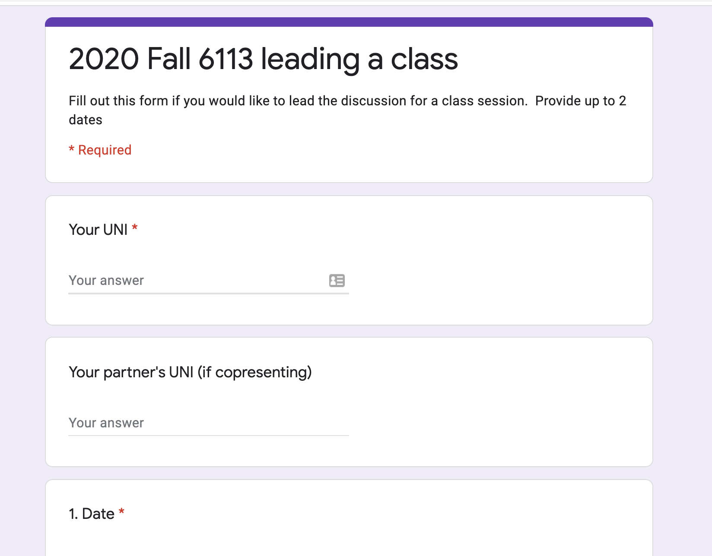
Logistics
Project proposals due 10/1
A2 due 10/4
Sign up to lead a class (TODAY)

Slide 24
DB seminar talks
9/29 Julia Stoyanovich (NYU)
Responsible Data Management
10/13 Wolfgang Gatterbauer (Northeastern)
QueryVis
10/20 Kostas Karanasos (Microsoft Gray Labs)
Lab overview + In-db ML inference
10/27 Vasiliki Kalavri (Boston U)
Streaming Research
11/10 Aaron Elmore (UChicago)
CrocodileDB
Zoom link in slack

Slide 25
Breakout Qs.
G1: Why is writing query optimizers harder than rocket science?
G2: Propose good methods to select promising transitions
G3: What are some benefits of volcano’s top-down search as compared to selinger’s algorithm? Hint: consider enforcers
G4: How to parallelize cascades? What challenges may arise?
Each group assigns notetaker to report back (1m)

Slide 26
Class 6

Slide 27
Do The Following
Turn video on
Type in chat or say:
Agree or disagree
Batman is a criminal
3. Click when done

Slide 28
Logistics
Project proposals due 10/1
A2 due 10/4
Sign up to lead a class (link on website, slack)

Slide 29
DB seminar talks
9/29 Julia Stoyanovich (NYU)
Responsible Data Management
10/13 Wolfgang Gatterbauer (Northeastern)
QueryVis
10/20 Kostas Karanasos (Microsoft Gray Labs)
Lab overview + In-db ML inference
10/27 Vasiliki Kalavri (Boston U)
Streaming Research
11/10 Aaron Elmore (UChicago)
CrocodileDB
Zoom link in slack

Slide 30
Breakout Qs. Provide specific examples
G1 Writing: What did the paper focus on & not focus on? Why?
G2 Contribs: What is the main contribution?
Design an example that highlights it against prior work.
G3 Exps: Based on the paper’s aims, what exps should they have run? Did they? If not, design a specific exp they should have run.
G4 Future: Describe a major follow up question to study.
Each group assigns notetaker to report back (1m)

Slide 31
Breakout
Discussion:
Discuss
Notetaker:
Summarize the discussion (~30s)

Slide 32
Class 5

Slide 33
Do The Following
Turn video on
Type in chat or say:
My favorite time of day is
___ ______
3. Click when done

Slide 34
Logistics
Today: multi-machine joins
A2 is out – optimizer!
A1 – what did you learn? What did you already know?

Slide 35
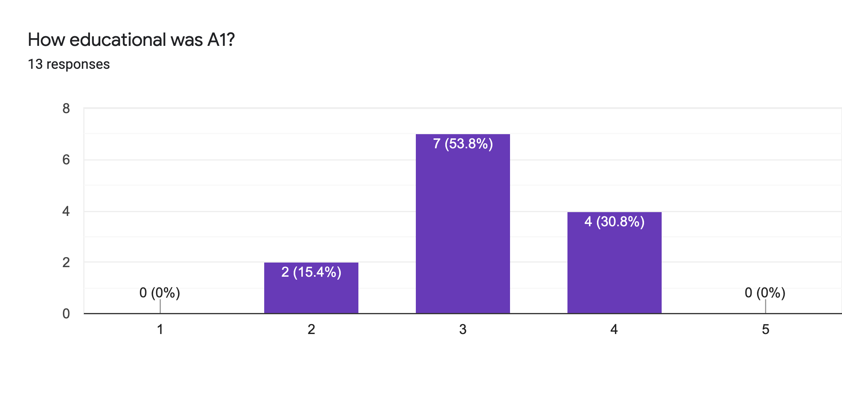
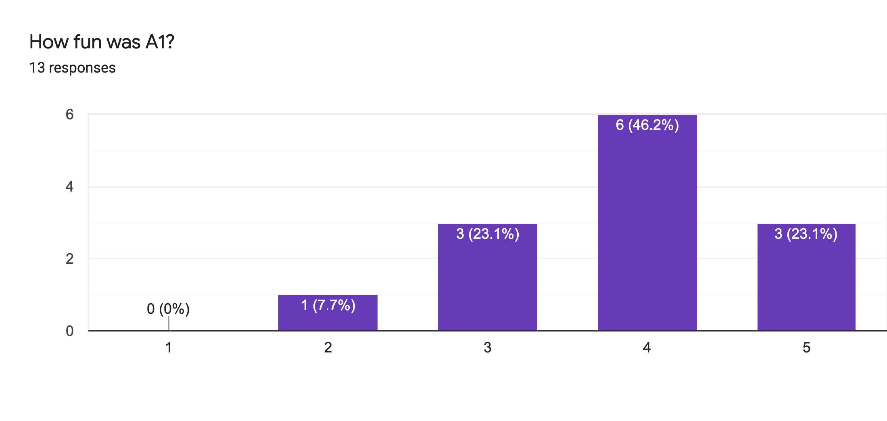
Main Comments
Vague Instructions
Bugs 🙏

Slide 36
Reviews
Strengths
Clear, honest writing
Ability to scale up/out is a big win!
Experiment design + explanation: A+

Slide 37
Reviews
Weaknesses
Lacks baselines
Aggregation?
Explain terms
How to choose partitioning key?
If scales to 1000+ nodes, what bottlenecks?
Failure on recovery?

Slide 38
Class 4

Slide 39
Do The Following
Turn video on
Type in chat or say:
A book/article I recently read
was ___ ______
3. Click when done

Slide 40

Today’s session
Finish previous class NO NEED!
Single Machine Joins.
Poll: paper reviews in pairs?

Slide 41
Today’s session
Finish previous class NO NEED!
Single Machine Joins.
Poll: paper reviews in pairs?
Poll: random pairing each week?

Slide 42
Breakout
Discussion:
Is a hot dog a sandwich? Discuss
Notetaker:
Summarize the discussion (~30s)

Slide 43
Discussion
Novelty
Theoretical guarantees
Experiment design

Slide 44
Class 3

Slide 45
Do The Following
Turn video on
Type in chat or say:
My favorite morning drink is ___ ___
(as much detail as you wish)
3. Click
Participants
Chat

Slide 46
Today’s session
Finish previous class
Multi-dimensional indexing
A1 is out, due 9/20

Slide 47
Breakout
Discussion:
Share your favorite quick cooking recipe,
or what you would like to cook
Notetaker:
Summarize the discussion (~30s)

Slide 48
Discussion
Novelty
Theoretical guarantees
Experiment design

Slide 49
Class 2

Slide 50
Turn video on,
enable mic & say:
“Hi, this is _(name)_,
I ate ___________ for breakfast”
Click when done
Participants
Chat

Slide 51
Logistics
Walk through
A0
Paper Reviews
Project list is up (still evolving)
Course goal
You feel comfortable reading papers + conducting research
Research ~ answering your own questions

Slide 52

Today’s session
Finish previous class
Review classic DBMS components
Notes on w6113.github.io

Slide 53
#ScholarStrike
Notes:
Supposed to be a two day strike where you don’t do any professor related tasks and learn about BLM and challenges of underrepresented people, and what can be done to help

Slide 54
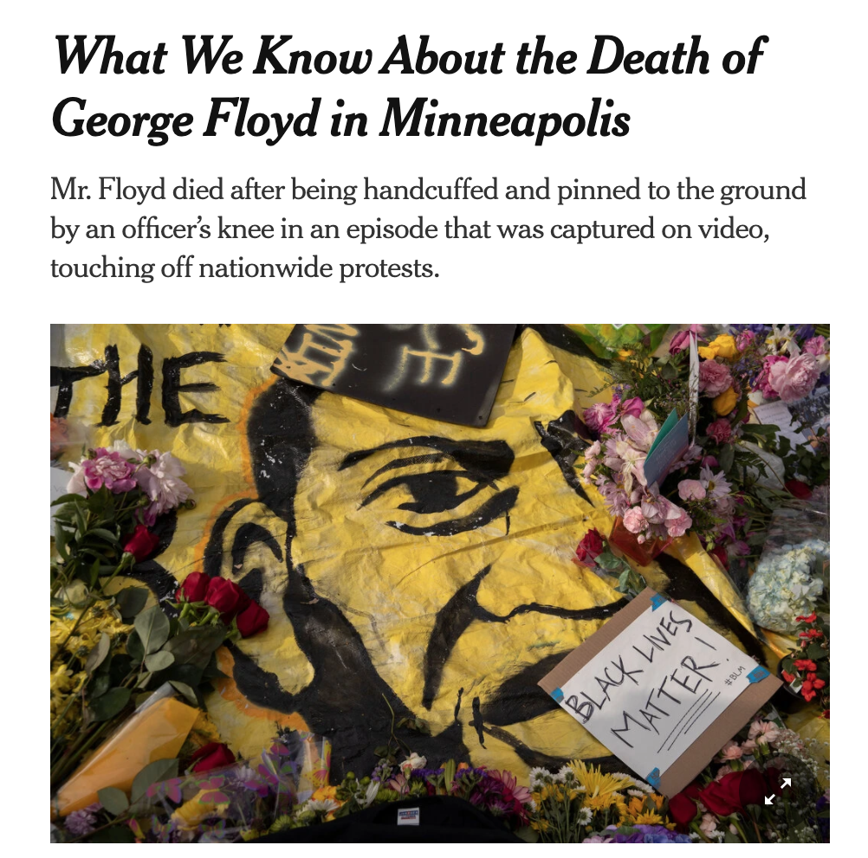
Black Lives Matter
Notes:
Discuss where all of this started and popularized this year, which, for me was the black lives matter protests.
BLM has been around for many years, but the very public, and unfair, murders of black people by police ignited the movement
For instance, geore floyd

Slide 55

Black Lives Matter
Notes:
Breonna Taylor was a nurse just at home in her apartment

Slide 56

Black Lives Matter
Notes:
Linden Cameron was a 13 year old shot in the back

Slide 57

Black Lives Matter
Notes:
And Daniel Prude who was pinned and hooded by officers, who then blamed it on drug overdose, which leverages deep seated biases about black people.
These events are tragic, and simply symptoms of a deep disparity between African americans and the rest of America.
The US has historically treated immigrants of all kinds poorly, but African americans have been systematically oppressed from day one of the nation’s founding.
BLM is simply the manifestation of the outrage at this inequity

Slide 58

Notes:
Recently the WNBA led the sports world in going on a strike to further publicize this issue, and other sports leaguse followed.
ScholarStrike was a reaction by academics in support of this

Slide 59
Search terms to learn more
john oliver police
Netflix 13th
The case for reparations
shutdownstem
Notes:
Rather than cancel class, I’ll list here terms that are worth searching for to educate your self a bit about what’s going on. We will share these terms in the slack.
These are issues that I am not an expert in either, but I am happy to discuss these in recitation or OH.

Slide 60
Your Tasks for next class
Submit reviews for Tuesday
Submit Assignment 0 by 9/13 11:59PM EST
w6113.github.io

